Slide 1
Sample Timers for Powerpoint

Slide 2
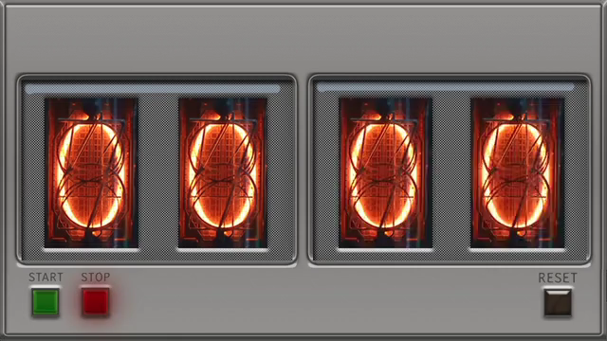
One minute timer (actually just an MP4 video of a timer)
Click on image and ‘play it’ to get a one minute count up.
A bit crude but effective. Under playback options can set ‘loop until stopped’

Slide 3
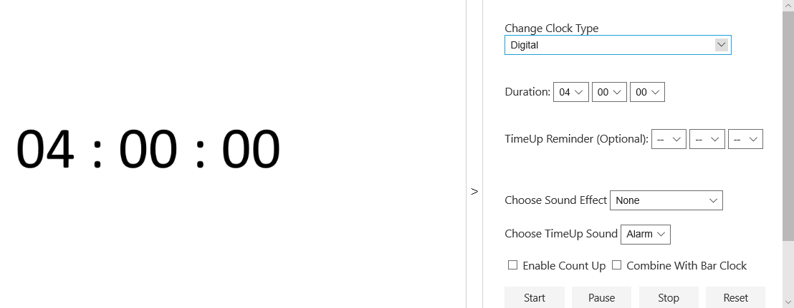
Configurable timer which can be displayed as one of several kinds of clock
Analog
Digital
A slide bar where slider moves left to right with elapsed time.
Options to right allow setting the options including sound effects.

